Slide 1
Data driven predictive modeling for PARP1 inhibition
Ryan Friedrich, PharmD Candidate
Butler University
Mentor: Amanda Paulson Ph.D.
2021 ATOM Internship Symposium | July 30, 2021

Slide 2
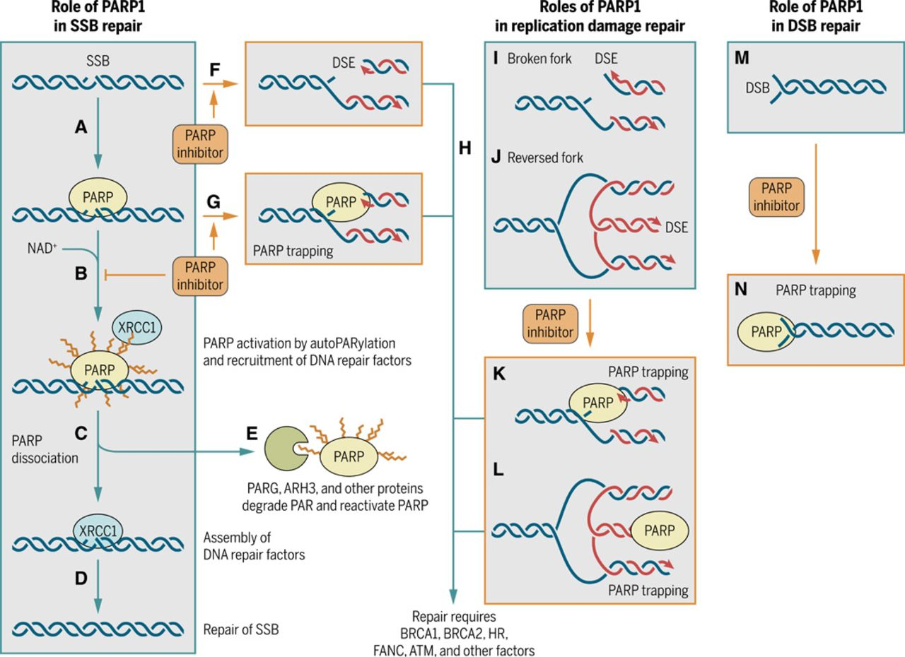
Background of PARP1 Inhibition
PARP1 functions in DNA damage repair.
Inhibition: Synthetic lethality cancer cells.
Prevents tumor DNA damage recovery.
More targeted therapy than traditional radio/chemotherapies.
BRCA mutated ovarian and breast cancers. Many of its approvals.
Pommier, Y., O’Connor, M. J., & Bono, J. de. (2016, October 26). Laying a trap to kill cancer cells: PARP inhibitors and their mechanisms of action. Science Translational Medicine. https://stm.sciencemag.org/content/8/362/362ps17.full.
Notes:
-Cut down on text

Slide 3
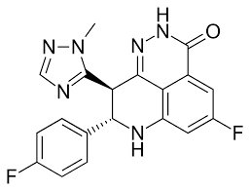
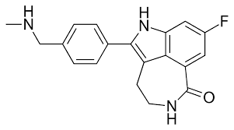
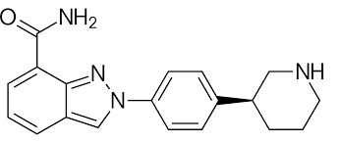
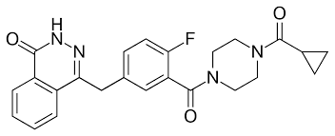
Background of PARP1 Inhibition
Goal: Identify new and stronger PARP1 inhibiting molecules.
olaparib
rucaparib
talazoparib
niraparib
Parp1 Selective Inhibitors. PARP1 inhibitor PARP1 Selective inhibitors PARP1 isoform specific inhibitor. (n.d.). https://www.selleckchem.com/subunits/PARP1_PARP_selpan.html?gclid=Cj0KCQjw3f6HBhDHARIsAD_i3D_6oH6EgK4eYdOPEGUEIZN60Zkd-EYO9qwGmYj99aKJRD9QVuO58hwaAq_HEALw_wcB.
Notes:
Four FDA approved PARP1 inhibitors:
Machine learning modeling predicts PARP1 inhibiting potency based on structure.
Need for new and improved cancer therapies:
More effective, less adverse effects, reach different and new target sites.
Computational methods save costs researching of new candidates.

Slide 4
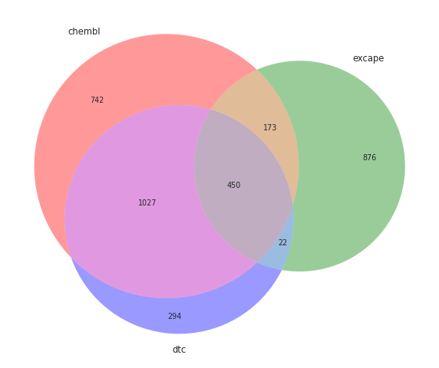
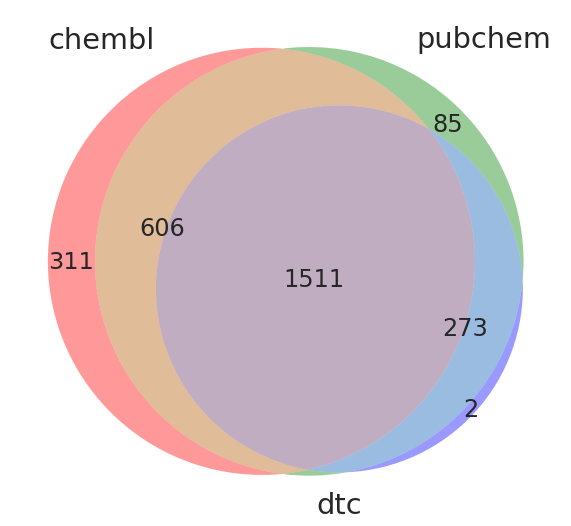
Methods – Data Sources
Databases: ChEMBL, PubChem, DTC, and Excape.
Info: Molecular structure, Ki or IC50 value, experimental assay used.
SMILES strings for structure. Standardized with RDKit.
Lack of useable data on Pubmed and Google Scholar.
Molecules with multiple reported values were averaged for the final actual value.
Outlier values removed based on a certain standard deviation.
Notes:
Published articles focused on one structural template and assessed how changes of one substituent effects values.
No available diverse sets of PARP1 inhibitors.

Slide 5

Value Types
IC50 = concentration of inhibitor required to reduce the enzymatic activity to half of the uninhibited rate
Ki = dissociation equilibrium constant of an enzyme inhibitor complex

Slide 6
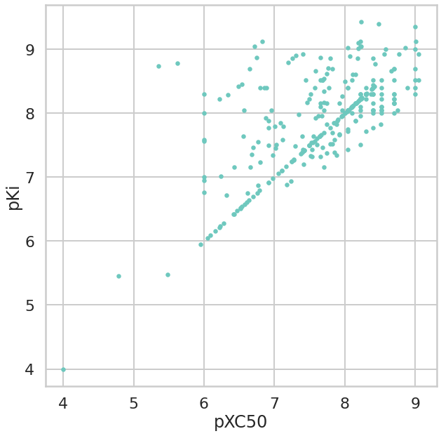
Challenges in Curation: Excape data
Many molecules have matching pXC50 and pKi.
Different measures are correlating way too closely.
Issue:
Excape dataset – reported IC50 and Ki values without distinction.
No way to identify value type.
Excape could have increased compound diversity.
Removed Excape data
pKi vs pXC50 values for molecules with both values:

Slide 7
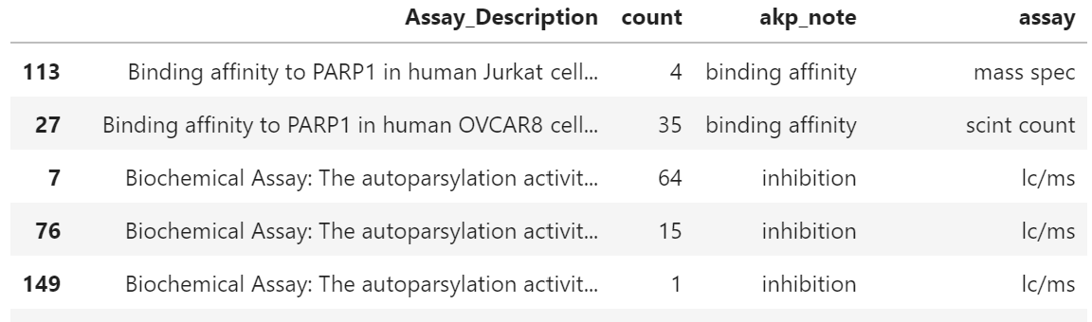
Assays
Confirm each assay is measuring for inhibition.
Identify the type of assay used to find each value.
Remove values from incompatible assay descriptions.
Example description: “Inhibition of PARP1 by microplate scintillation counting”
Inhibition, scint count
Notes:
Values determined experimentally and provided the assay type used.
Assay descriptions compared to ensure combinable results.
Incomparable assay descriptions removed.
Assay types such as cell-based assays and binding affinity were removed.
Checked correlations between different assay types
Assays without detailed descriptions were checked based on correlation with rest of data.

Slide 8
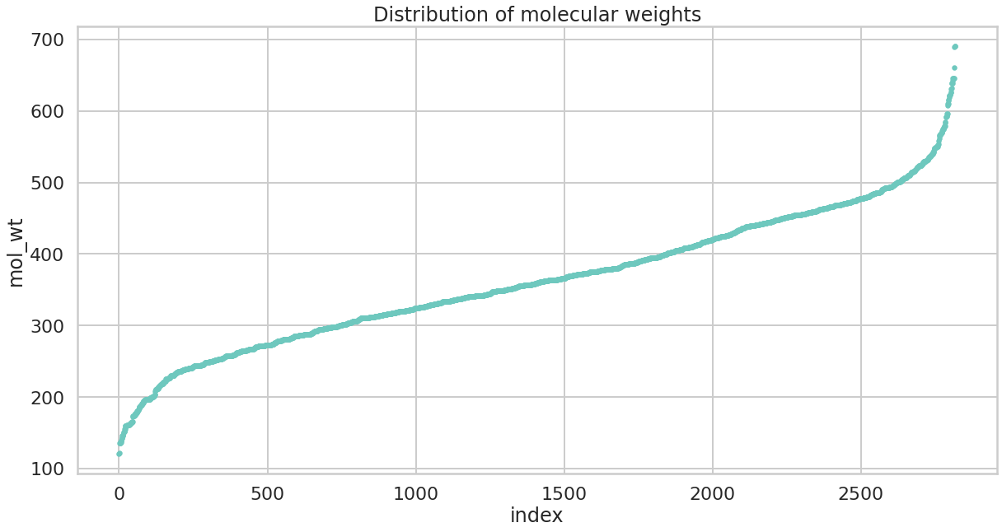
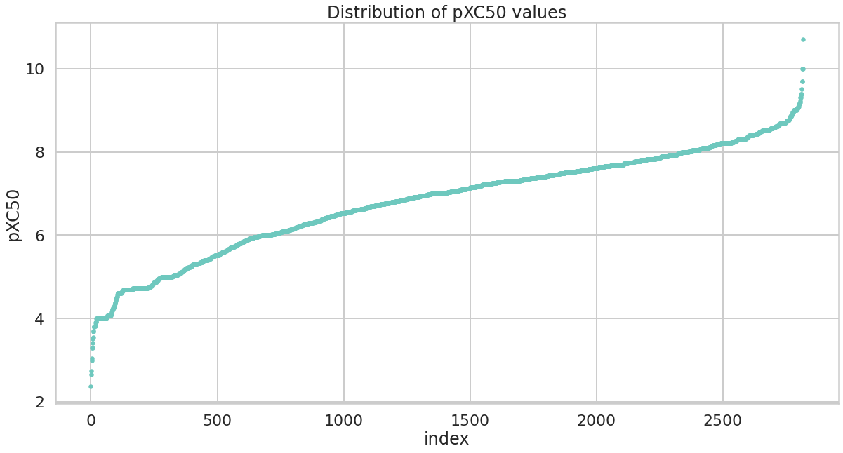
XC50 Data – Distributions of PARP1 Inhibiting Compounds
Final XC50 dataset = 2,818 molecules
Based on threshold = 7 for pXC50: 1404 active and 1414 inactive molecules
2,622 molecules with molecular weights under 500.
Positive sign for developability of molecules
May hinder model in predicting larger molecules

Slide 9
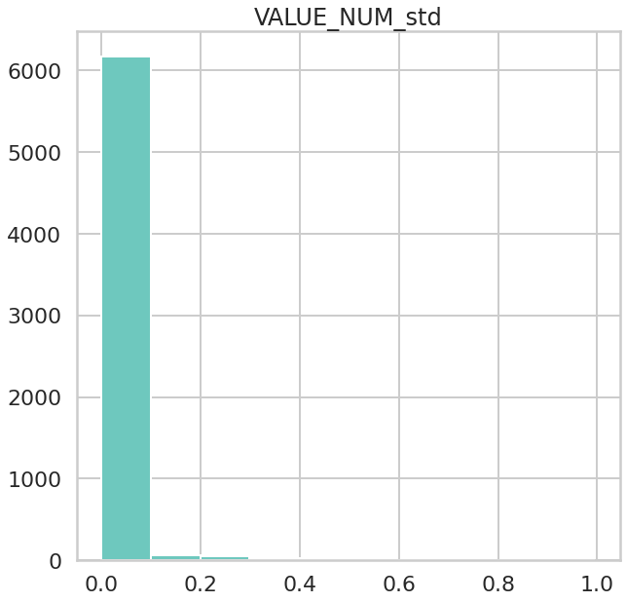
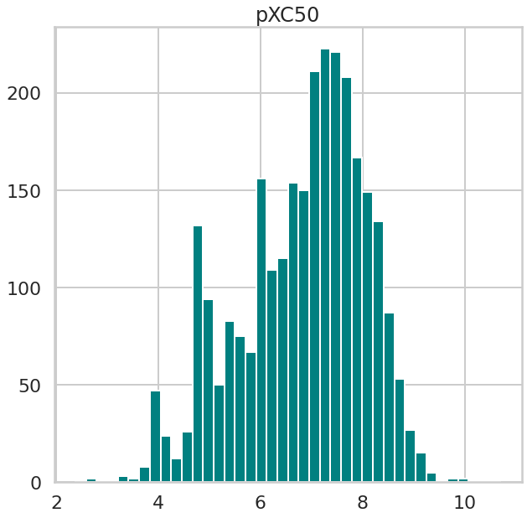
XC50 Data – Distributions of PARP1 Inhibiting Compounds
Distribution of pXC50 standard deviations
Distribution of pXC50 values
Required no additional dropping of outlier values.

Slide 10
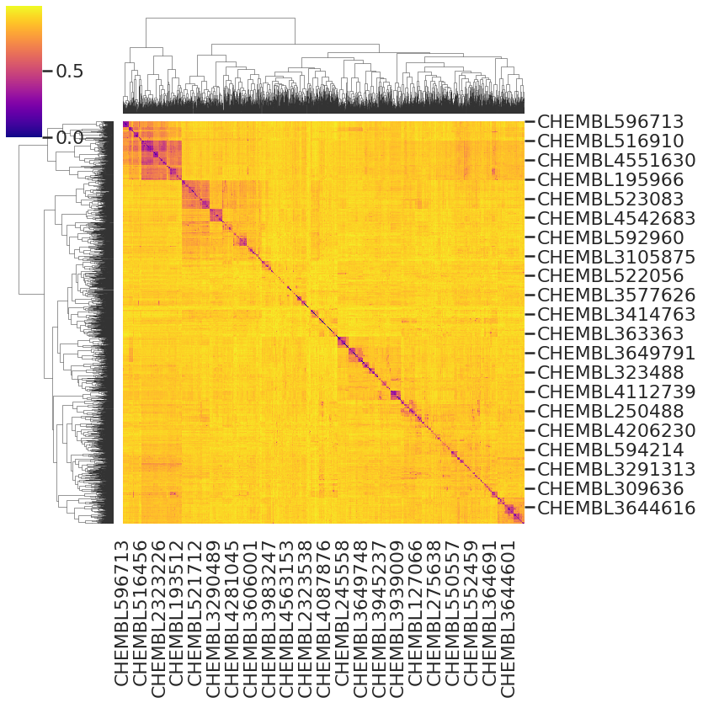
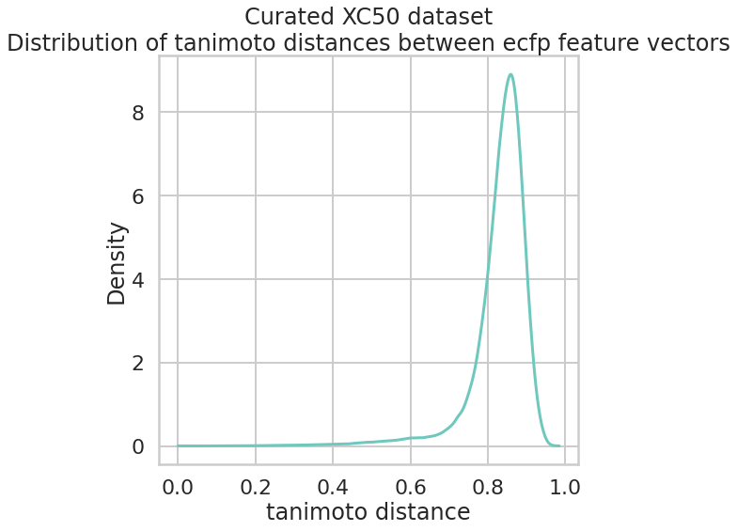
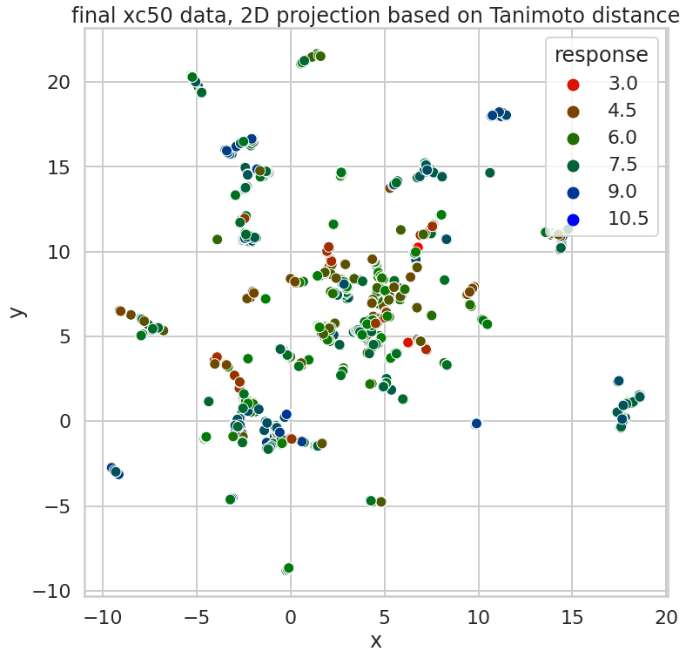
XC50 data – Diversity of Molecules
2D projection of tanimoto distances for molecules in XC50 data
Distribution of tanimoto distances for molecules in XC50 data
Notes:
Density of tanimoto distance peaks at 0.85
Large degree of diversity, some shared features.
2D projection of Tanimoto distances dispersed across entire plot
Clustered toward center but little overlap
Small amount of purple along diagonal axis signifies high diversity.

Slide 11
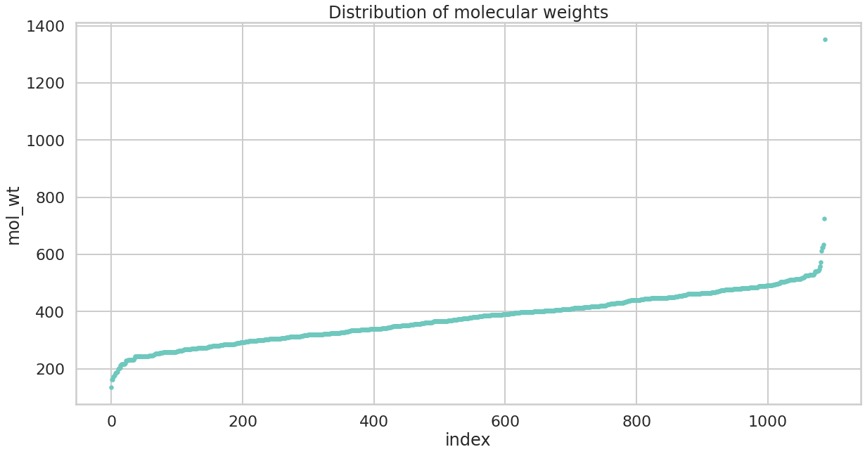
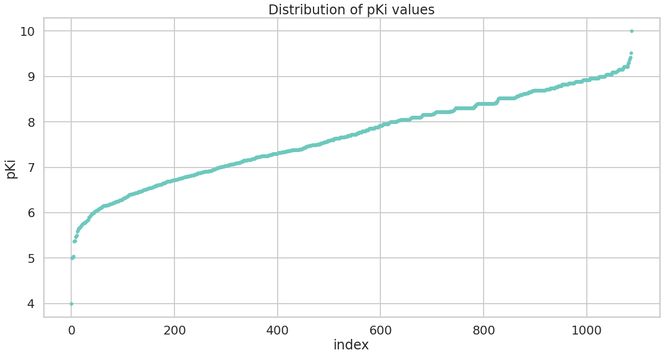
Ki Data – Distributions of PARP1 Inhibiting Compounds
Final Ki dataset = 1,088 molecules
Based on threshold = 7.7 for pKi: 545 active and 543 inactive molecules
1,017 molecules with molecular weights under 500.
One molecule with MW ~ 1350.
One molecule pKi ~ 10

Slide 12
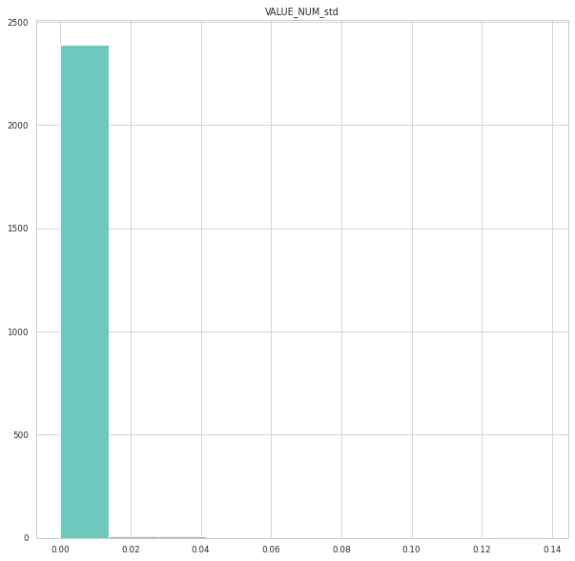
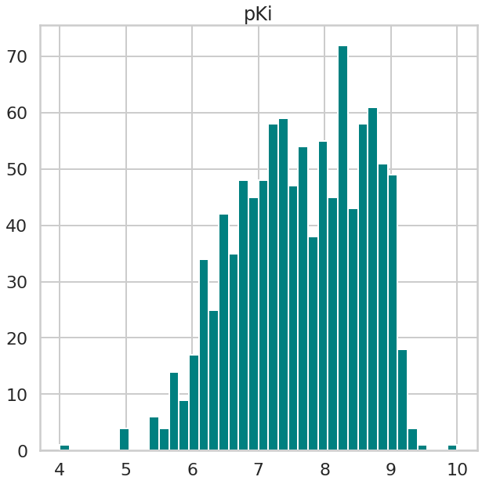
Ki Data – Distributions of PARP1 Inhibiting Compounds
Distribution of pKi standard deviations
Distribution of pKi values
Notes:
pKi values extremely low standard deviations.
No standard deviations even exceed 0.05
No additional dropping of outlier values needed.
Bulk of pKi values fall between 6.5 and 9
pKi values shifted higher than pXC50 values

Slide 13
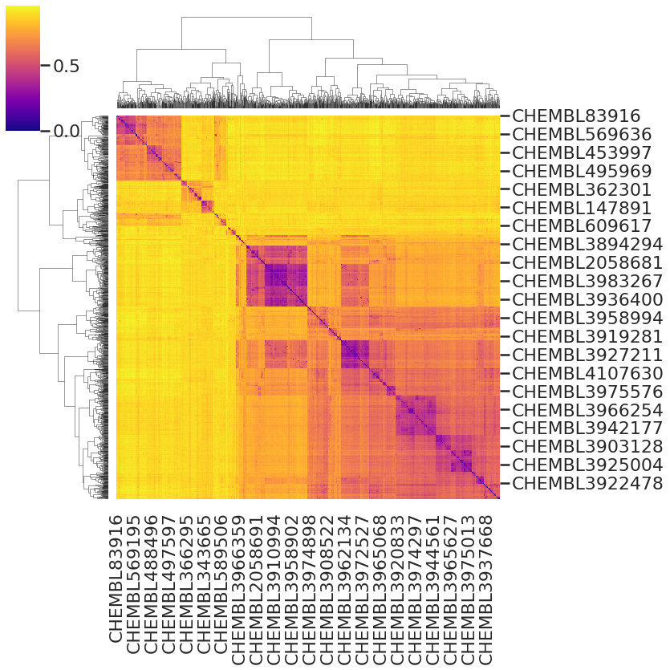
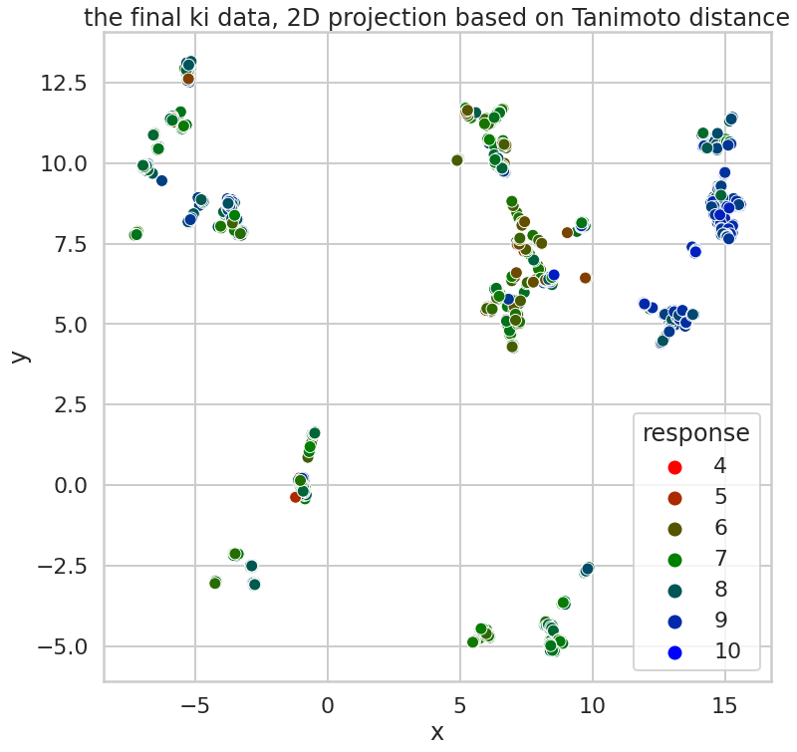
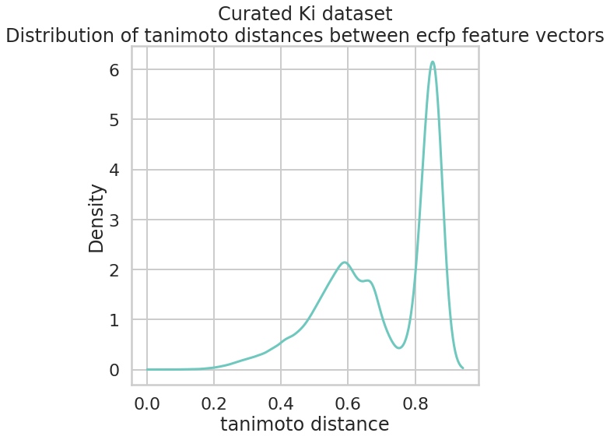
Ki Data – Diversity of Molecules
2D projection of tanimoto distances for molecules in Ki data
Distribution of tanimoto distances for molecules in Ki data
Notes:
Density of tanimoto distance peaks around 0.85.
Additional peak at 0.6
Signifies less diversity
Less diverse than XC50 data
The 2D projection: several isolated clusters of highly similar molecules.
Molecules fall into ‘structural groups’ much more than XC50 data.
Much more purple along diagonal axis than compared to XC50 data.

Slide 14
Best Models:
XC50:
Regression: Valid R² = 0.6443 Random Forest with Mordred
Classification: Valid ROC AUC score = 0.8985 Random Forest with ECFP
Ki:
Regression: Valid R² = 0.7454 Random Forest with ECFP
Classification: Valid ROC AUC score = 0.978 by graph convolutional neural networks
Best performers: Random Forest, ECFP

Slide 15
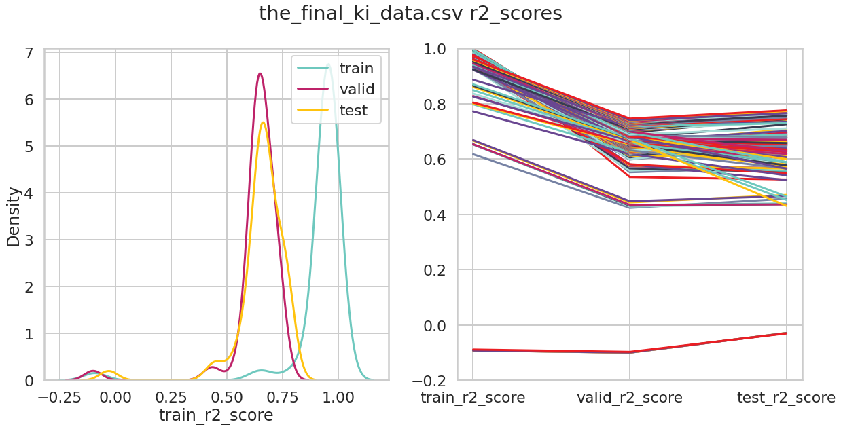
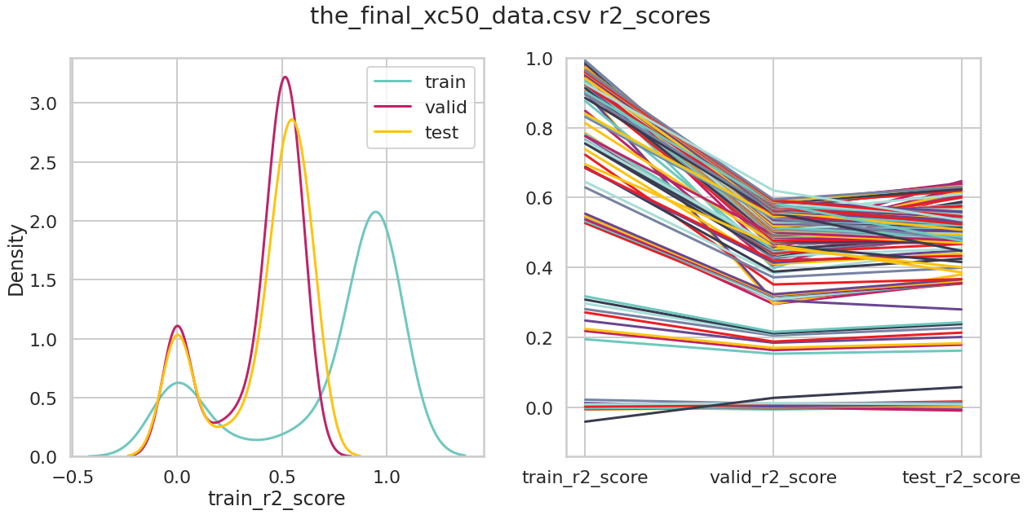
Results
Used neural networks, random forests, and XgBoost.
Descriptors: ECFP, MOE, Mordred, RDKit, and graph convolutional neural networks.
Ki dataset consistently produced higher performing models than the XC50 dataset
Despite ~ 1/3 of the size
R² Scores from Ki Data
R² Scores from XC50 Data
Majority of Ki regression r2 scores ~ 0.55 – 0.75
Majority of XC50 regression r2 scores ~ 0.4 – 0.6

Slide 16
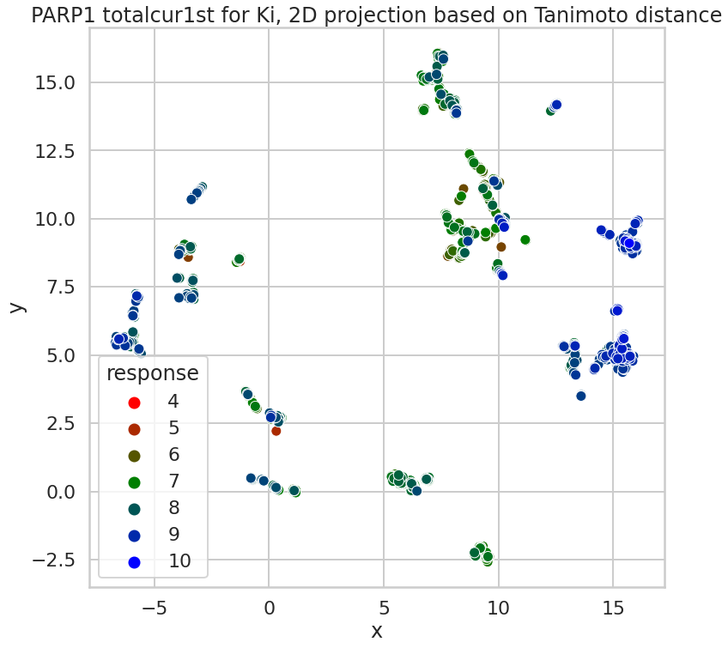
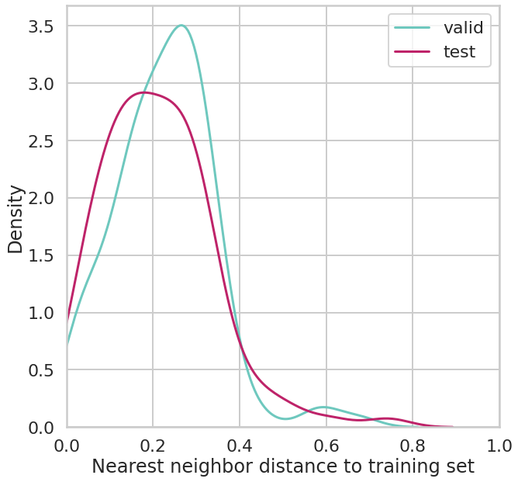
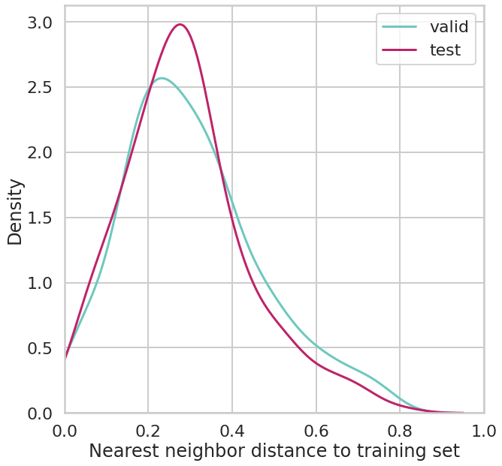
XC50 and Ki: Differences in model performance
2D projection of tanimoto distances for molecules in Ki data
Tanimoto distances to most similar molecule in Ki data
Ki values more consistent for the same molecules.
Standard deviations were extremely small
Maybe Ki was a more stable measurement relating closer to structure.
Lack of diversity could have led to models “memorizing” values from train set compounds.
2D projection of tanimoto distances for molecules in XC50 data
Tanimoto distances to most similar molecule in XC50 data
Notes:
Then making predictions based on the train values from that “cluster” of highly similar molecules rather than truly predicting based on structure.
Both explanation could be involved

Slide 17
Future Directions
Build model to predict both Ki and IC50 values.
Gather more data, specifically Ki values to add diversity.
Use insights from modeling to help predict new PARP1 inhibitors.
Find way to incorporate Excape data and identify value types.

Slide 18
Acknowledgements
Amanda Paulson Ph.D.
Caleb Class Ph.D.
Da Shi Ph.D.
Sarangan Ravichandran Ph.D.
Susan Mertis Ph.D.
Thank you for all of you help!

Slide 19
Sources:
Malyuchenko, N. V., Kotova, E. Y., Kulaeva, O. I., Kirpichnikov, M. P., & Studitskiy, V. M. (2015). PARP1 Inhibitors: antitumor drug design. Acta naturae. https://www.ncbi.nlm.nih.gov/pmc/articles/PMC4610162/.
Slade, D. (2020, March 1). PARP and PARG inhibitors in cancer treatment. Genes & development. https://www.ncbi.nlm.nih.gov/pmc/articles/PMC7050487/.
Pommier, Y., O’Connor, M. J., & Bono, J. de. (2016, October 26). Laying a trap to kill cancer cells: PARP inhibitors and their mechanisms of action. Science Translational Medicine. https://stm.sciencemag.org/content/8/362/362ps17.full.
Fu, L., Wang, S., Wang, X., Wang, P., Zheng, Y., Yao, D., Guo, M., Zhang, L., & Ouyang, L. (2016, December 5). Crystal structure-based discovery of a novel synthesized PARP1 inhibitor (OL-1) with apoptosis-inducing mechanisms in triple-negative breast cancer. Nature News. https://www.nature.com/articles/s41598-016-0007-2.
Wang, S., Han, L., Han, J., Li, P., Ding, Q., Zhang, Q.-J., Liu, Z.-P., Chen, C., & Yu, Y. (2019, October 28). Uncoupling of PARP1 trapping and inhibition using selective PARP1 degradation. Nature News. https://www.nature.com/articles/s41589-019-0379-2.

